Slide 1
First ground observations of Saturn's spokes around 2009 equinox
Marc Delcroix, Emil Kraiikamp & Padma Yanamandra-Fisher
Commission des observations planétaires University of Groningen Space Research Institute
Société Astronomique de France Netherlands USA (delcroix.marc@free.fr) (ekraaikamp@gmail.com) (padma@spacescience.org)
EPSC-DPS 2011, Nantes, France, October 6th 2011

Slide 2
Content
Spokes
Data
First spoke observation from ground
Spokes detections in 2010 and 2011
Possible relation to storms
Conclusion
First ground observations of Saturn's spokes around 2009 equinox - Marc Delcroix, Emil Kraiikamp and Padma Yanamandra-Fisher - EPSC-DPS 2011, Nantes, France, Oct. 7th 2011
2
Notes:
2

Slide 3
Spokes
Discovered by Voyager 1 and 2 in:
Nov. 1980 (Ls* 8° / δ_{sun}** 4°)
and Aug. 1981 (Ls 18° / δ_{sun} 8°) around vernal equinox
Intermittently appearing radial or elongated dark markings in Saturn’s B-ring due to sub-microns dust particles levitated above the ring.
Characteristics:
Appear dark in backscatter, bright in forwardscatter.
Rotates at Saturn’s synchronous radius of 1.86 R_{s}*
Observed near morning/evening ansae.
* : Saturn’s radius
Spokes imaged by Voyager ISS
First ground observations of Saturn's spokes around 2009 equinox - Marc Delcroix, Emil Kraiikamp and Padma Yanamandra-Fisher - EPSC-DPS 2011, Nantes, France, Oct. 7th 2011
3
Notes:
3

Slide 4
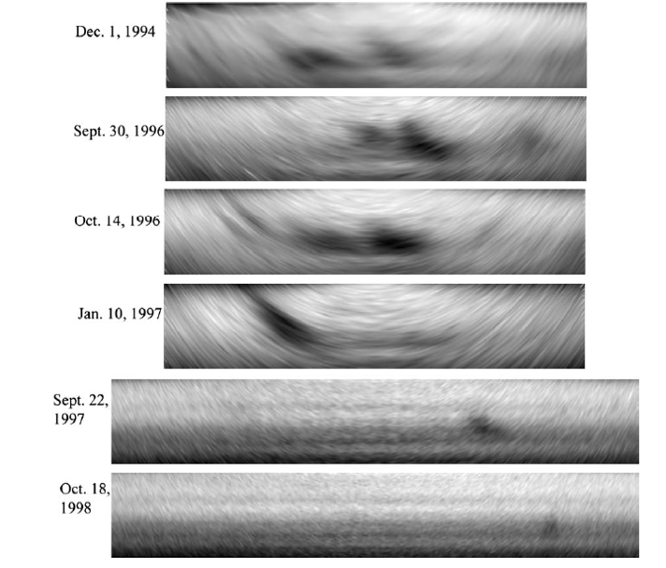
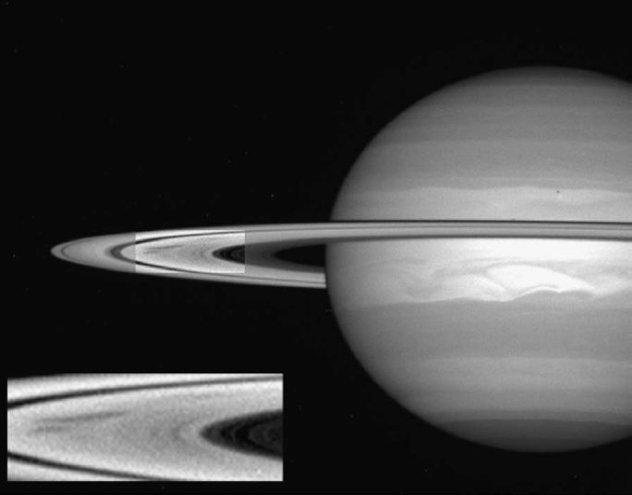
Spokes
Observed between Dec. 1994 and Oct. 1998 by HST (Ls [168°-216°] / δ_{sun} [5°- 15.5°] / δ_{earth}* [8°- 15°]) around autumnal equinox
=> Observations depending on geometry/illumination
* : Earth declination from Saturn
Spokes imaged by HST
First ground observations of Saturn's spokes around 2009 equinox - Marc Delcroix, Emil Kraiikamp and Padma Yanamandra-Fisher - EPSC-DPS 2011, Nantes, France, Oct. 7th 2011
4
Notes:
4

Slide 5
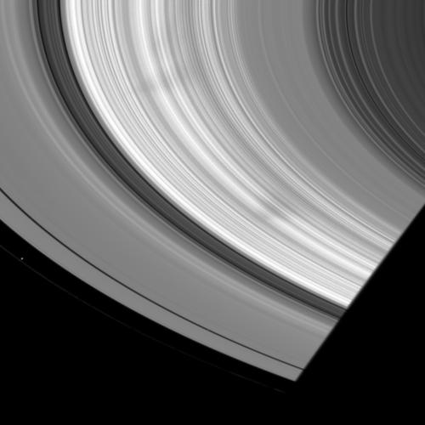
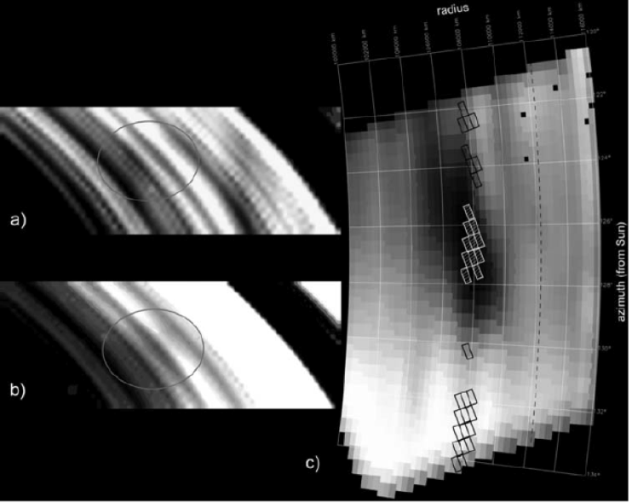
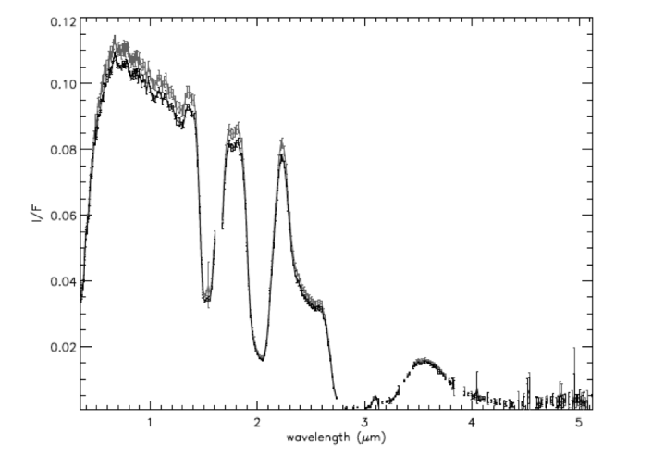
Spokes
Observed by Cassini ISS/VIMS since Sept. 5th 2005 (Ls 309° / δ_{sun} -20,5°) before vernal equinox [De’versa et al. 2010]
Near-Ir spectrum indicates water ice
Two spokes imaged by Cassini ISS WA on July 8th 2008 © NASA/JPL/Space Science Institute
First ground observations of Saturn's spokes around 2009 equinox - Marc Delcroix, Emil Kraiikamp and Padma Yanamandra-Fisher - EPSC-DPS 2011, Nantes, France, Oct. 7th 2011
5
Notes:
5

Slide 6
Data
- 250 observations (animations) have been studied:
- from 180 amateur observers
- since 2007
- Criteria for selections of spokes candidates :
- not over-processed images to avoid false detections due to artifacts
- animations showing features in B-ring rotating in the same direction as the planet
- Confirmation of spokes if following conditions are fullfilled :
- located between 1.65 Rs* (within B-Ring) and 1.95 Rs (Cassini division) as co rotation is at 1.86 Rs
- Longitude system III (LIII) in two images minimum is identical within +/-5°
* : Saturn radius
First ground observations of Saturn's spokes around 2009 equinox - Marc Delcroix, Emil Kraiikamp and Padma Yanamandra-Fisher - EPSC-DPS 2011, Nantes, France, Oct. 7th 2011
6
Notes:
6

Slide 7
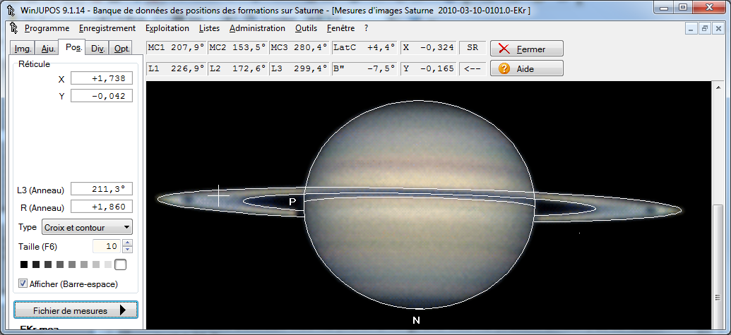
Data
- For 2010 opposition data, (LIII, Rs) of spoke “center” measured with WinJupos software
- Uncertainty in measurement is high due to small ring tilt (ex: +/- 3° LIII, +/- 0,05 Rs) and possible inaccurate timing of image
First ground observations of Saturn's spokes around 2009 equinox - Marc Delcroix, Emil Kraiikamp and Padma Yanamandra-Fisher - EPSC-DPS 2011, Nantes, France, Oct. 7th 2011
7
Notes:
7

Slide 8
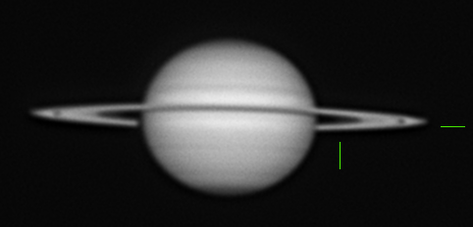
First spoke observation from ground
- The first confirmed observation (starting from 2007) was done by Emil Kraiikamp, from Netherlands during the 2009-2010 apparition, on March 10th 2010
Animation of 17 frames taken on March 10th 2010, with a red filter on a 254mm Newtonian reflector © E. Kraiikamp
- this observation was performed :
- under a small and unfavorable ring tilt (3.6°)
- at Ls 7° / δ_{sun} 3.2° (near equinox)
- with a red filter (better resolution, less sensitive to turbulence)
- Uncertainty in measurement is high due to small ring tilt (ex: +/- 3° LIII, +/- 0,05 Rs)
01h30UT enhanced image © E. Kraiikamp /processing M. Delcroix
First ground observations of Saturn's spokes around 2009 equinox - Marc Delcroix, Emil Kraiikamp and Padma Yanamandra-Fisher - EPSC-DPS 2011, Nantes, France, Oct. 7th 2011
8
Notes:
8

Slide 9
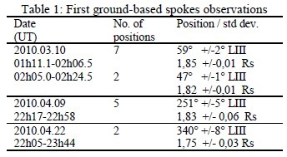
Spokes detections in 2010
- During the 2009-2010 apparition, spokes have been identified at three occasions (all observations from E. Kraiikamp), with two different spokes on March 10th, one on April 9th and 22nd
- These spokes were located around 1.8 Rs, at various longitudes :
First ground observations of Saturn's spokes around 2009 equinox - Marc Delcroix, Emil Kraiikamp and Padma Yanamandra-Fisher - EPSC-DPS 2011, Nantes, France, Oct. 7th 2011
9
Notes:
9

Slide 10
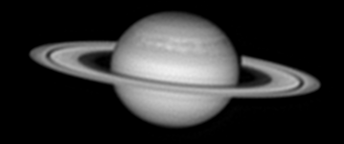
Spokes detections in 2011
- During the 2010-2011 apparition, out of 114 animations (December 2010 to August 2011), 62 candidate (not yet confirmed by measurement, including simultaneous observations on two occasions) spoke observations have been identified, from 22 different observers.
- These occurred between Dec. 23rd 2010 and April 30th 2011, with a ring-tilt between 10.3° and 7.8° and between Ls 17° / δ_{sun} 7.5° and Ls 23° / δ_{sun} 9.3°
- Only 4 of them show spokes candidates in the evening B-ring ansae, 61 in the morning ansae (3 times both)
Two spoke candidates in the morning ansae (left) taken on March 20th 2011, with a red filter. GWS is also visible in the NTrZ. © E. Kraiikamp
First ground observations of Saturn's spokes around 2009 equinox - Marc Delcroix, Emil Kraiikamp and Padma Yanamandra-Fisher - EPSC-DPS 2011, Nantes, France, Oct. 7th 2011
10
Notes:
10

Slide 11
Possible relation to storms
- a storm has been observed (107 observations) by amateurs from March 4th to June 28th 2010, in Storm Alley (35°S planetocentric latitude). It rapidly evolved into several bright spots over an extended zone.
- The first spoke observations occurred only 6 days after the apparition of the new storm which was then becoming brighter. The other spokes were observed when the storm was separated clearly into two spots.
These observations occurred only when the storm was active, with various phase angles (around 55°, 45°, -125° and -45° LIII)
2009-2010 apparition
- a Great White Spot, a one per 30 years event, started on Dec. 5th 2010 in the North hemisphere (lying at the equivalent latitude as Storm Alley) and raged during all apparition, covered continuously by amateurs (1700 observations).
- from end of December 2010 to end of April 2011, an extremely high number of spokes candidates have been detected starting after the GWS was detected.
There could be a relation between the exceptional planet-scale event in Saturn atmosphere and the large number of spokes candidates detection.
2010-2011 apparition
First ground observations of Saturn's spokes around 2009 equinox - Marc Delcroix, Emil Kraiikamp and Padma Yanamandra-Fisher - EPSC-DPS 2011, Nantes, France, Oct. 7th 2011
11
Notes:
11

Slide 12
Conclusion
- Around 2009 equinox, amateurs imaged for the first time spokes :
- in B-ring, in the zone co-rotating with the planet’s magnetic field
- only when they also observed white spots related to storm activity in the atmosphere
- between Ls [7°,23°], δ_{sun} [3.2°,9.3°], ring-tilt from earth [3.6°,10.3°]
- till Apr. 30th 2011 (reason yet to be found)
- Amateur coverage of Saturn atmosphere and rings can have an interest for professional studies of spokes, and their relation to Saturn’s atmospheric events
- Further study of 2010-2011 apparition spokes candidates is needed to derive spoke longitude, position in the rings, life duration and their potential relation to the storm(s) in the GWS
Thank you – questions ?
First ground observations of Saturn's spokes around 2009 equinox - Marc Delcroix, Emil Kraiikamp and Padma Yanamandra-Fisher - EPSC-DPS 2011, Nantes, France, Oct. 7th 2011
12
Notes:
12

